Slide 1
#include <stdio.h>
void changeVal(struct Node* n) {
n->key *= 10;
}
int main() {
struct Node {
int key;
};
struct Node n, *p;
n.key = 192;
p->key = 193;
//…
}
1
2
3
4
5
6
7
…
Notes:
Bugs:
struct Node is not defined outside of main. Compiler cannot resolve parameter type for function changeVal()
pointer is being dereferenced before being initialized.
Would there be any bugs if we removed the changeVal() declaration? No, until line 6.
Is this how we access a struct attribute from a pointer?

Slide 2
#include <stdio.h>
struct Node {
int key;
};
void changeVal(struct Node* n) {
n->key *= 10;
}
int main() {
struct Node n, *p;
p = malloc(sizeof(struct Node));
n.key = 192;
p->key = 193;
/**************where we left off*****************/
printf("n.key:%d p->key:%d\n", n.key, p->key);
changeVal(&n);
changeVal(p);
printf("n.key:%d p->key:%d\n", n.key, p->key);
return 0;
}
Notes:
Can we pass n directly into changeVal()?
struct Node is not the same type as struct Node *

Slide 3
#include <stdio.h>
#pragma warning(disable : 4996)
struct Person {
int id;
char name[30]; // need padding?
char gender;
}x, *y;
int main() {
y = &x;
scanf("%d", &(y->id));
printf("%d\n", x.id);
scanf("%s", (*y).name);
printf("%s\n", (&x)->name);
fflush(stdin);
x.gender = getchar();
printf("%c\n", y->gender);
return 0;
}
Accessing Members of a Struct
1
2
3
4
5
6
7
8
9
Notes:
If a structure involves an integer, a pointer, or a float, the structure size must be multiples of 4 in 32-bit (multiple of 8 in 64-bit) machines.
How many bytes in struct Person? 4 + 30 + 1 = 35 + 1 byte of padding = 36.
1 byte of padding.
Where? between id and name[30].
struct Person x;
struct Person *y;
What is stored in *y at declaration? Garbage, 4 bytes.
size of x: 36 bytes.
size of y: 4 bytes.
scanf takes a pointer to the variable it must modify.
What is the order of operations? Do we need parentheses?
in scanf():
why do we use &(y->id)
but use y->name
?
Because one is a variable and the other is a pointer. scanf() operates on pointers, not values: it will dereference the 4 bytes passed in to it.
What does fflush do?
flushes buffer. Necessary when transitioning between formatted input to unformatted input. Failure to flush will read whitespace.

Slide 4
Questions
1. How large is the Person struct on a 32-bit machine?
36 bytes
38 bytes
40 bytes
42 bytes
2. Which of the following is equal to y->id?
&y->id
&x.id
x.id
*x->id
3. Which of the following is a valid replacement for line 7?
scanf(“%c”, &x->gender);
scanf(“%c”, &((*y).gender));
scanf(“%c”, x.gender);
scanf(“%s”, &y->gender);
4. If we input “Greg” for the name. What is the value of
*(y->name)?
The address of the array containing “Greg”
‘G’
The address of y
Undefined
5. What is the type of (&*y->name)?
char
struct Person*
char**
char*
struct Person {
int id;
char name[30];
char gender;
}
struct Person x, *y; y = &x;
x.gender = getchar();
Notes:
answers:
1 : a
2 : c
3 : b
&x->gender == &(x->gender)
scanf(“%s”, ...) String of characters. This will read subsequent characters until a whitespace is found (whitespace characters are considered to be blank, newline and tab). A null character is stored at the end of the string.
4 : b
5 : d
char is *y->name
struct Person* is y
char** in &y->name
&*y->name == y->name

Slide 5
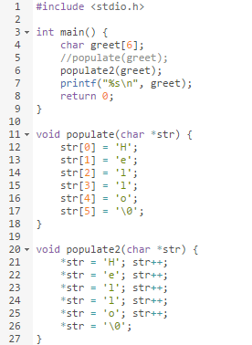
void populate(char*);
void populate2(char*);
string as char array
char array as char pointer to array element
Remember:
greet == &greet[0]
*greet == greet[0]
*greet + 2 == greet[2]
Notes:
Do these functions do the same thing?

Slide 6
Deep Copy: Clone
struct Node n;
n.key = 192;
struct Node m = n;
// the value of m.key is 192
Future changes made to n
do not affect m.
Future changes made to m
do not affect n.

Slide 7
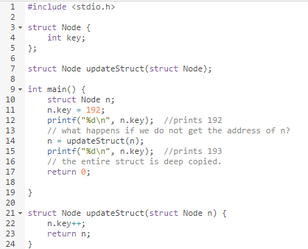
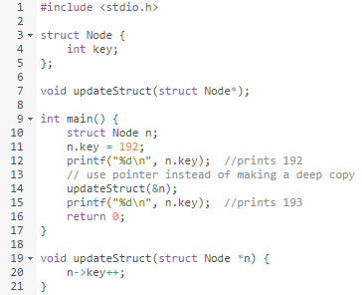
Passing struct Node to a function
Passing struct Node pointer to a function
Notes:
Should we pass the address of a struct to a function, or the struct itself?
Deep Copy: Clone
struct Node n;
n.key = 192;
struct Node m = n;
// the value of m.key is 192
Future changes made to n
do not affect m.
Future changes made to m
do not affect n.

